Slide 1
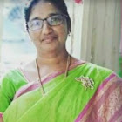
KNOWLEDGE AND CURRICULUM
Unit V - Education and Democracy
Dr.V.Regina
Principal ,Asst,Professor of Biological Science
CSI Bishop Newbigin College of Education
No.109, Dr.Radhakrishnan salai, Mylapore, Chennai - 600004

Slide 2
Synopsis
Introduction
Democracy
John Dewey’s concept of democracy
Democracy and education
Citizenship training
Multiculturalism and education
Conclusion
Dr. V. Regina , Principal CSI BISHOP NEWBIGIN COLLEGE OF EDUCATION

Slide 3
Learning Objectives
To ensure the explicit curriculum - based components.
To develops resources for learners and educators
To appraises the educational experiences.
Protects the humans rights of all citizens.
Responses citizenship training actively
Analyses equality, equity and harmony.
Learning Outcomes
Dr. V. Regina , Principal CSI BISHOP NEWBIGIN COLLEGE OF EDUCATION

Slide 4
By the people
Political power
Freedom and equality
DEMOCRACY -Definition
Dr. V. Regina , Principal CSI BISHOP NEWBIGIN COLLEGE OF EDUCATION

Slide 5
Rule of law
Freedom of speech
Respect of human
Enlightened citizen
DEMOCRACY -Principles
Dr. V. Regina , Principal CSI BISHOP NEWBIGIN COLLEGE OF EDUCATION

Slide 6
Equal opportunity
Compulsory education
Government offices
Expansion of universities
Differently abled children
Adult education
Massive tasks
Obstacles
Rights and duties
DEMOCRACY - And education
Dr. V. Regina , Principal CSI BISHOP NEWBIGIN COLLEGE OF EDUCATION

Slide 7
Rights and duties
Brotherhood
Dignity of labour
Evaluation
Merits and demerits
Prevent exploitation
Voter legislator
Laws of land
Fundamental rights
Importance of Education in Democracy
Dr. V. Regina , Principal CSI BISHOP NEWBIGIN COLLEGE OF EDUCATION

Slide 8
Hand-on learning
Mass education
Laboratory
Classroom
Co-operative work
Informal education
His beliefs
John dewey's concept of
Democracy and education
Dr. V. Regina , Principal CSI BISHOP NEWBIGIN COLLEGE OF EDUCATION

Slide 9
Different Culture
Cultural diversity
Valves
beliefs
Multiculturalism - Introduction
Dr. V. Regina , Principal CSI BISHOP NEWBIGIN COLLEGE OF EDUCATION

Slide 10
Justice
Freedom
Tolerance
Sources of multiculturalism
Dr. V. Regina , Principal CSI BISHOP NEWBIGIN COLLEGE OF EDUCATION

Slide 11
Equal education
Cultural pluralism
Education equality
Multiculturalism and Education
Dr. V. Regina , Principal CSI BISHOP NEWBIGIN COLLEGE OF EDUCATION

Slide 12
Content integration
Knowledge construction
Prejudice reduction
Equity pedagogy
Empowering school culture
Dimensions of Multiculturalism in Education
Dr. V. Regina , Principal CSI BISHOP NEWBIGIN COLLEGE OF EDUCATION

Slide 13
Develop the knowledge
To participate
Do in action
Goals of Multiculturalism education
Dr. V. Regina , Principal CSI BISHOP NEWBIGIN COLLEGE OF EDUCATION

Slide 14
Contribution
Additive
Transformation
Social action
Levels of approaches in Multiculturalism In education
Dr. V. Regina , Principal CSI BISHOP NEWBIGIN COLLEGE OF EDUCATION

Slide 15
Justice
Equality
Fratanity
Renewed effort
Multilingual character
Multicultural Education in India
Dr. V. Regina , Principal CSI BISHOP NEWBIGIN COLLEGE OF EDUCATION

Slide 16
Thomas definition
Citizenship
The civil
Legal status
Citizenship Training - Introduction
Dr. V. Regina , Principal CSI BISHOP NEWBIGIN COLLEGE OF EDUCATION

Slide 17
Community awareness
Responsibility
Economic productivity
Self-development
Reflective thinking
Problem solving
Decision making
General goals of Citizenship
Dr. V. Regina , Principal CSI BISHOP NEWBIGIN COLLEGE OF EDUCATION

Slide 18
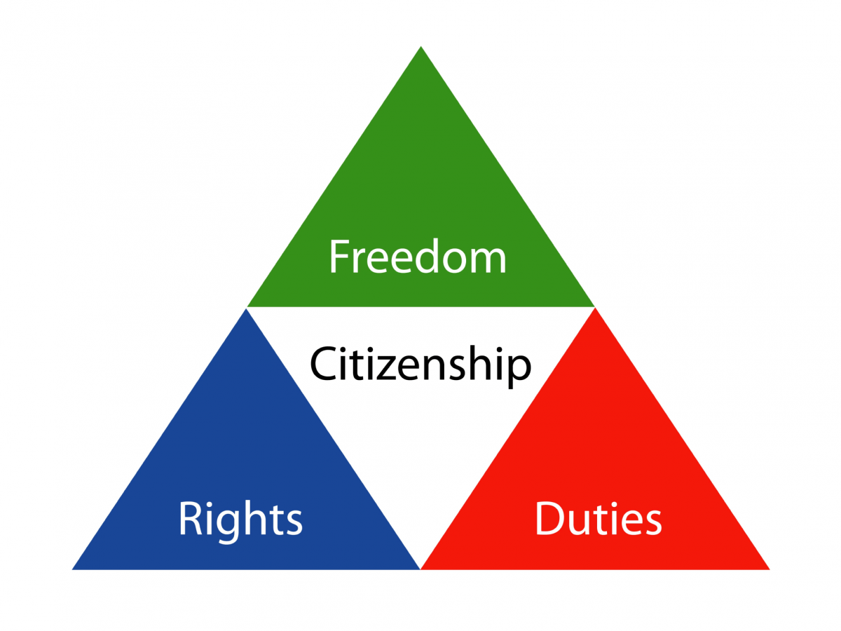
Citizen And Citizenship
CITIZENSHIP
EQUALITY
DIVERSITY
COMMUNITY
Dr. V. Regina , Principal CSI BISHOP NEWBIGIN COLLEGE OF EDUCATION

Slide 19
Dynamic work
Development
Debuts
Mock parliament
Excursion
Socialisation
SUPW
Camps
self-governance
Training in citizenship
Dr. V. Regina , Principal CSI BISHOP NEWBIGIN COLLEGE OF EDUCATION

Slide 20
Self-governance
Group activities
Manual work
Equality
Individuality
Social services
Camps
Community kitchen
Measures for educating and training the students for democracy
Dr. V. Regina , Principal CSI BISHOP NEWBIGIN COLLEGE OF EDUCATION

Slide 21
Conclusion
“A great man is different from an eminent one in that he is ready to be the servant of the society”
Thus our society needs our contribution for transformation
Dr. V. Regina , Principal CSI BISHOP NEWBIGIN COLLEGE OF EDUCATION

Slide 22
Suggestive Readings
Dewey , John (1916) Democrary and education.
Morn’s Debra and shapiro , Ian (1993) /John Dewey “the political writings, Indiannoa polis IN.Hackett publishing company.
Garrison , james W (1998) Democracy, scientific knowledge and teacher empowerment . Teachers college record 89(4), 487-504
Dr. V. Regina , Principal CSI BISHOP NEWBIGIN COLLEGE OF EDUCATION

